Slide 1
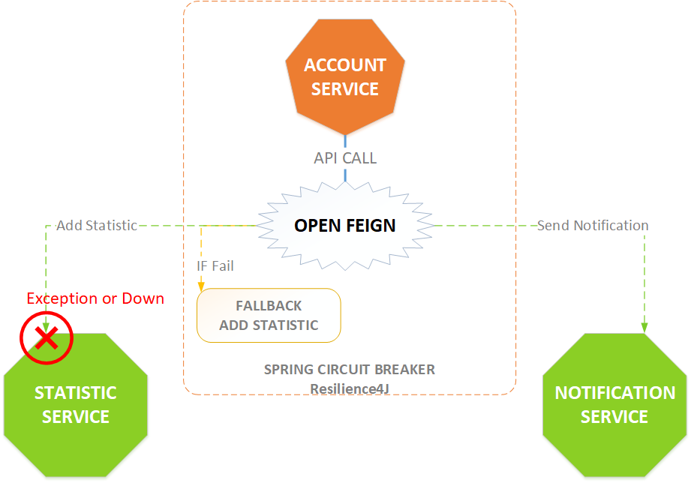

Spring Cloud Open Feign with Circuit Breaker Resilience4j Part 2
www.jmaster.io/course/microservices-with-spring-cloud

